Slide 1





Deep or Shallow Neural Network for Demosaicing
Prakhar Amba
David Alleysson
Martial Mermillod
Financement: FUI ExtremOWL F1411026U
21th Nov. 2018 GDR ISIS
prakhar.amba@univ-grenoble-alpes.fr

Slide 2
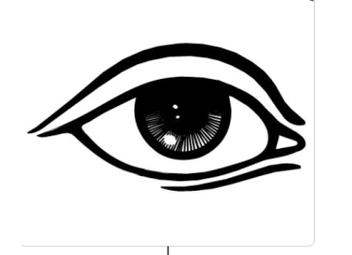
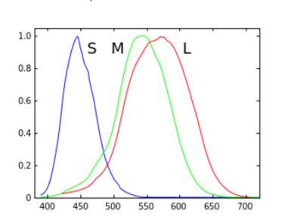
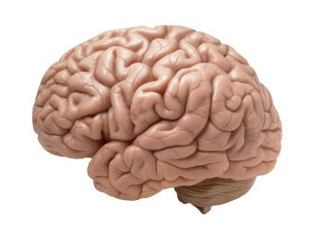

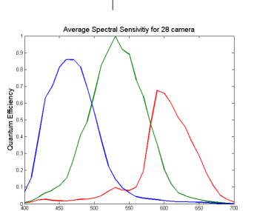

Trichromacy & Additive color model
Physics of Light
Additive color model
  can add RGB primaries to form any color
Used for image capturing and display

Slide 3
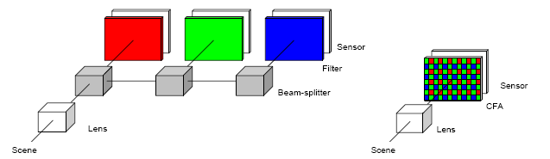
Demosaicing - Intro
To produce color image we need 3 color samples per pixel
Use three sensors for each color channel (expensive)
The sensor is overlaid with a Color Filter Array (CFA)
Interpolation of CFA image known as demosaicing
3 sensors
CFA before single sensor

Slide 4
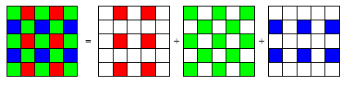

Slide 5
Spatial Demosaicing
Notes:
Green channel sampled by the camera
Frequency Domain Edge directed interpolation ^{[2,3]} interpolate along contour not across. Frequency selection. Algo based on edge directed. However they depend on the Cfa arrangement

Slide 6
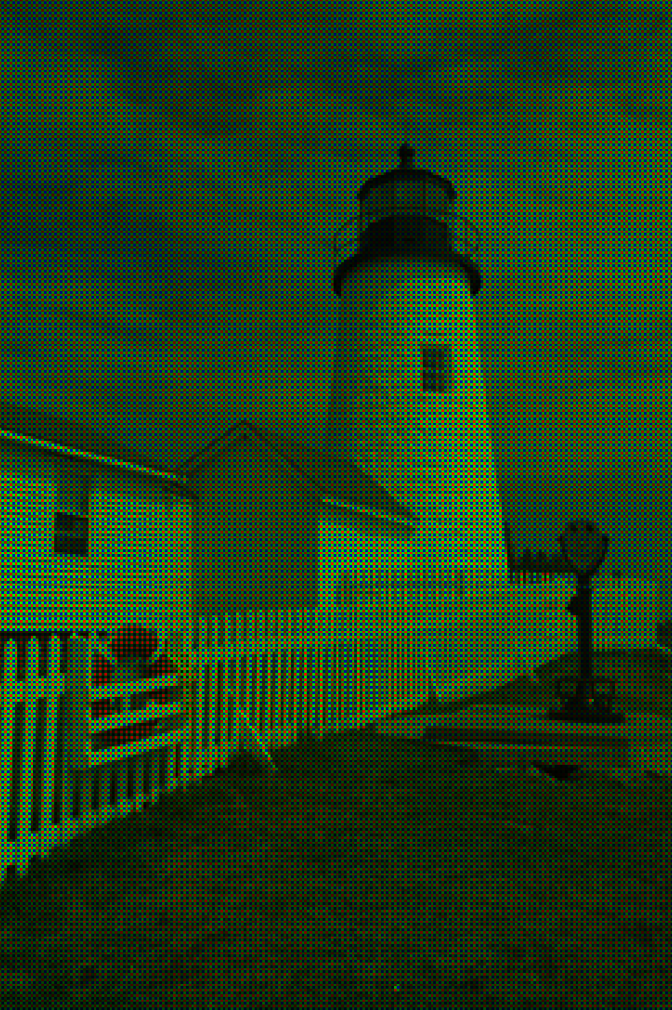
Camera CFA image

Slide 7
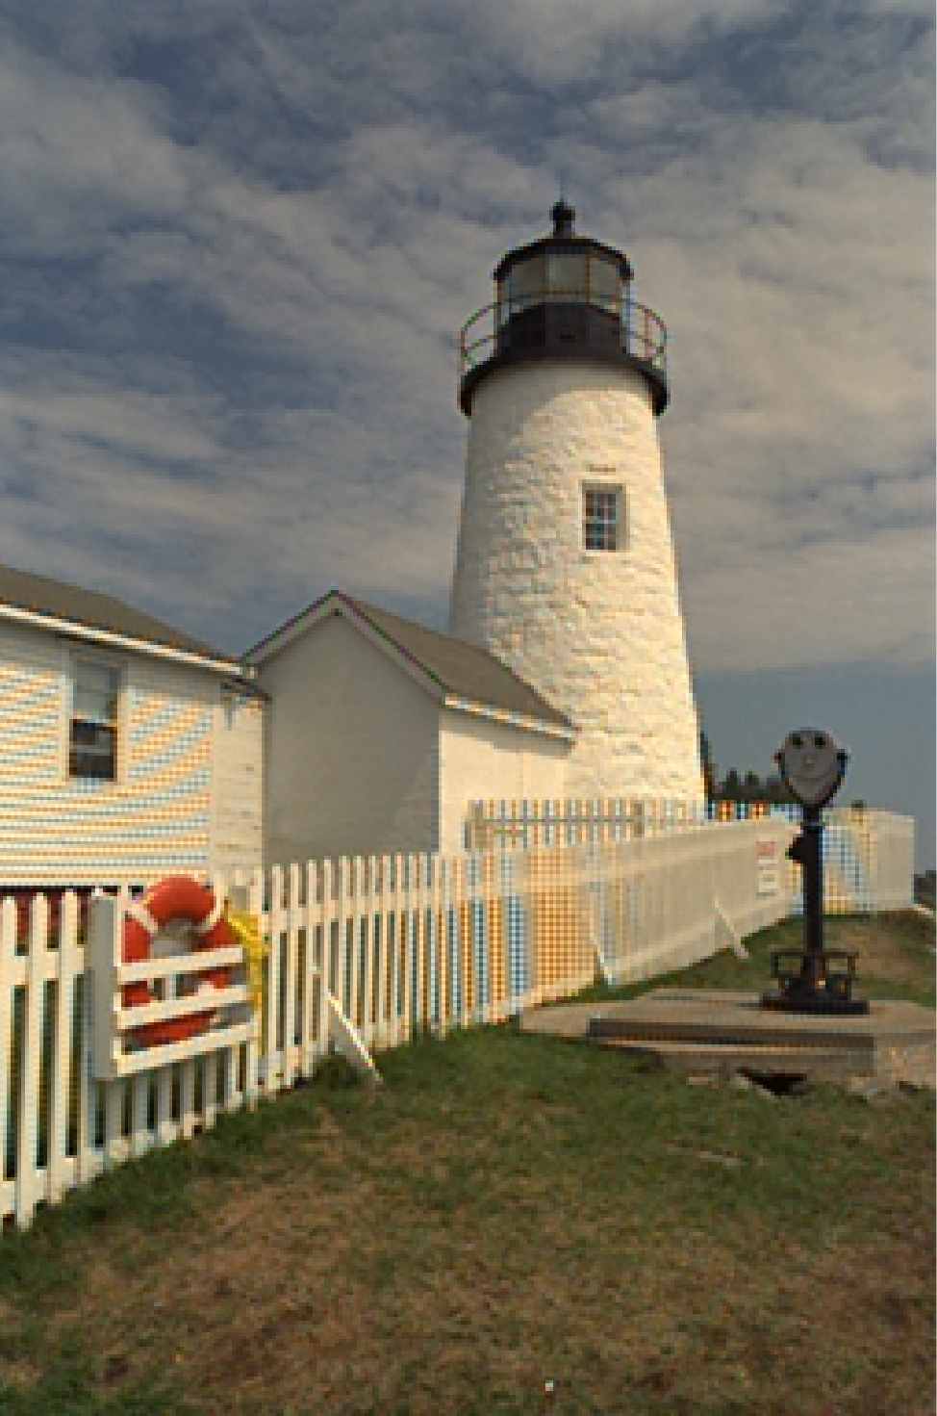
Camera CFA image
Recovered image
Notes:
Computation to remove those artifacts in your phone

Slide 8
State of ART
Several approaches to demosaicing to avoid these false colors and artifacts
  Edge-Aware
  Frequency Domain
  Graph theory
  Sparse learning, etc.
Recently approaches based on CNN using deep learning have been proposed

Slide 9
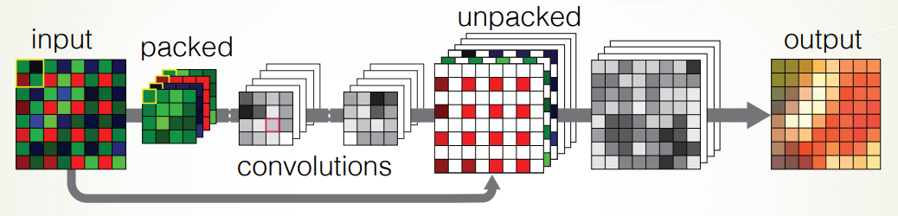
Deep Learning CNN
Gharbi et al.¹ proposed a Deep CNN with 15 layers
  Trained on 2.5 million images
Zhou et al. ² proposed Deep Residual CNN trained on 6000 images (16 MP)
Deep Learning requires large training dataset
¹Gharbi, Michaël, et al. "Deep joint demosaicking and denoising." ACM Transactions on Graphics (TOG) 35.6 (2016): 191.
²Zhou Ruofan, et al. “Deep Residual Network for Joint Demosaicing and Super-Resolution” CIC 26 ; arXiv preprint arXiv:1802.06573 (2018).

Slide 10
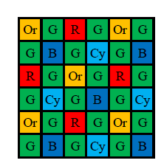
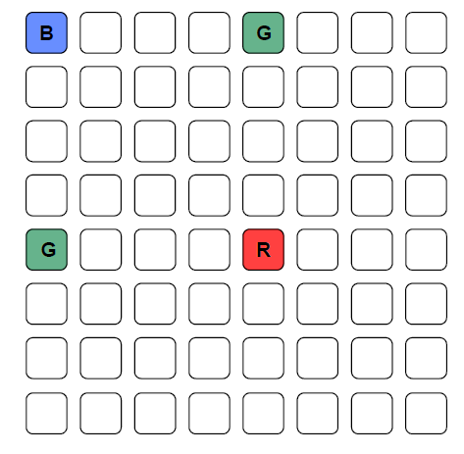
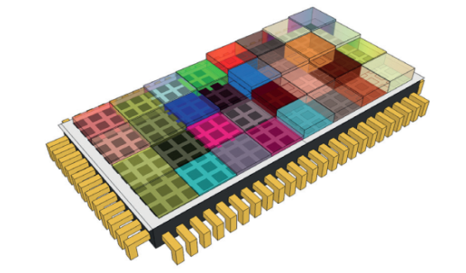
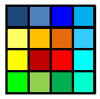
Spectral Filter Array
Any number of spectral filters layout in a filter array
Spatio-spectral sampling, sparse description of a scene
Applications include accurate color reproduction, machine vision, food and agriculture, chemical analysis, medical, cosmetics, night vision, etc.
Demosaicing for SFAs is a new challenge
We can train on hyperspectral database but they tend to be small in size
SFA by Monno et al.
5 filters
SFA by Silios
16 filters
SFA by IMEC
32 filters
SFA by E2V
RGBW
Notes:
Biggest reflectance database 256

Slide 11
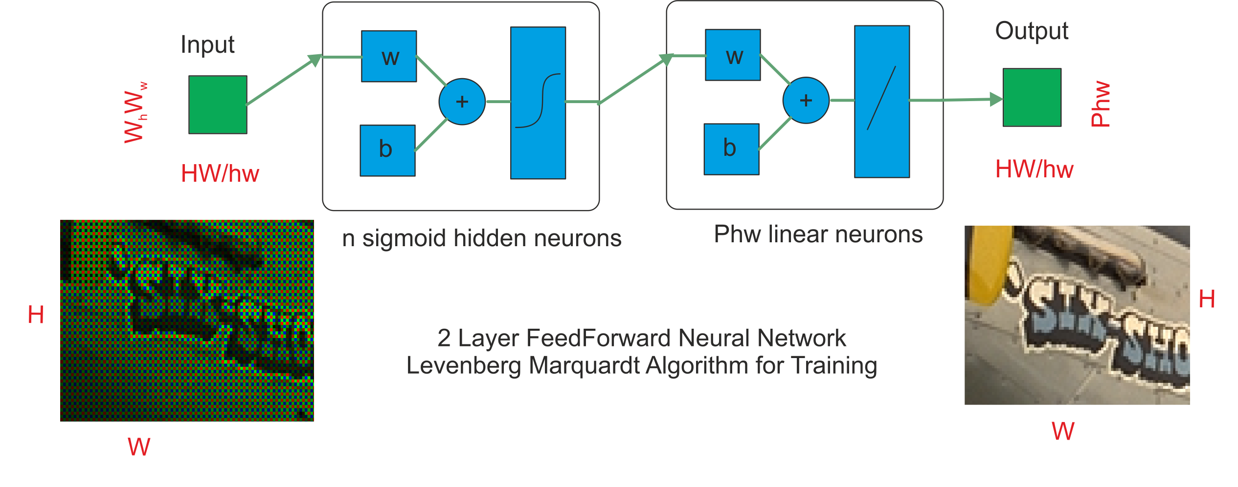
Proposed Neural Network
Simple 2 layer Feedforward Neural Network trained on few images
Notes:
Nn with neighborhood

Slide 12
Training on a Database
X
….
learn Neural Network
….
Y
We train the Neural Network on pairs of X and Y images
Notes:
Learn D on a database and apply on real raw data

Slide 13
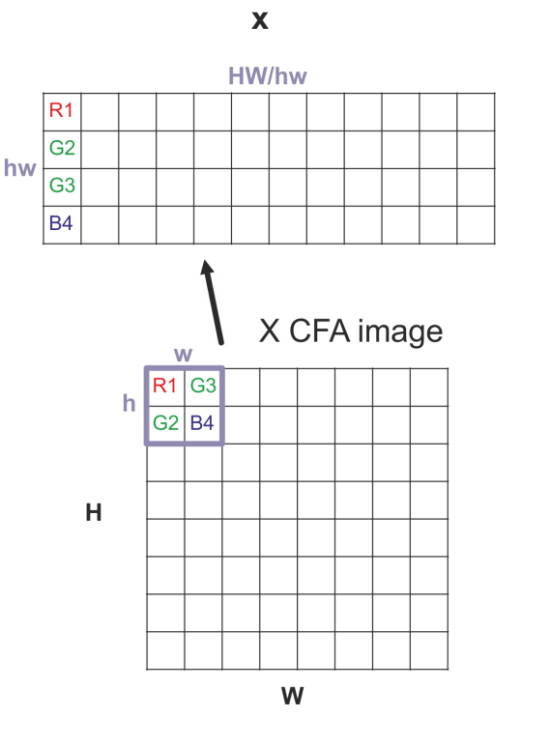
Training Input Data
Notes:
Insist in shift invariant pattern 2x2

Slide 14
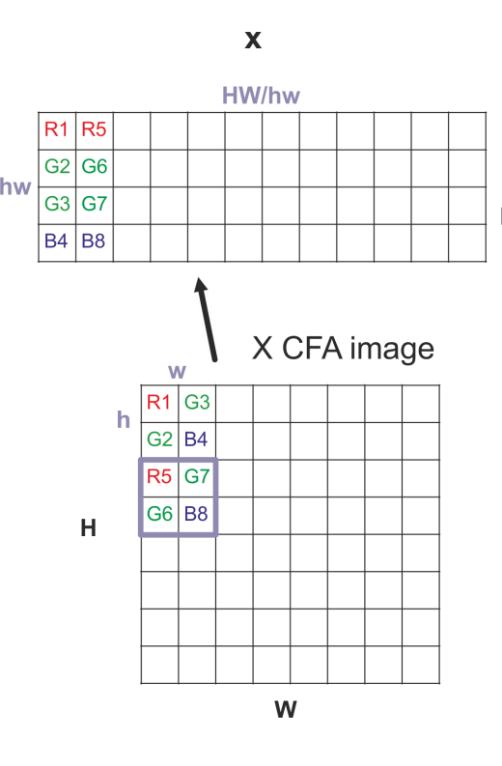




Training Input Data
$$HW/hw$$
$$W_{h}^{}W_{w}^{}$$
$$W_{w}^{}$$
$$W_{h}^{}$$
Introduce neighborhood

Slide 15
Testing RGB and RGBW CFAs
Used Kodak database for training
  70% of pixels used for training, 15% for validation, 15% for testing
Results for testing on 15% or complete 100%, very similar
For Bayer we used a neighborhood window of 10 x 10 with 100 neurons in first layers
  20.6 hours on Nvidia GTX 1080 + Intel i7 6700k
Notes:
Week long training for Deep learning network

Slide 16
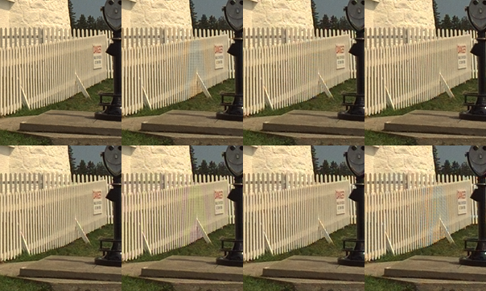





Results
Original
40.71dB
39.10dB
40.01dB
41dB
40.54dB
38.82dB
38.11dB
Gharbi et al. report 41.2 dB using 15 layer CNN for Bayer
Notes:
Bottom row: RGBW, Kodak 2.0, sony RGBW. For bayer we take 0.15s, while Gharbi take 0.98s (extrapolated).

Slide 17

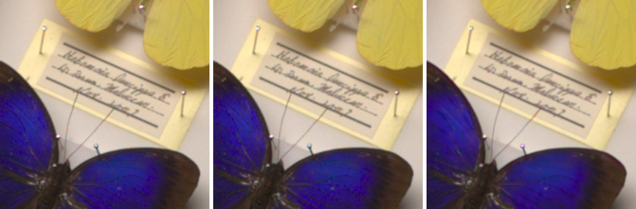
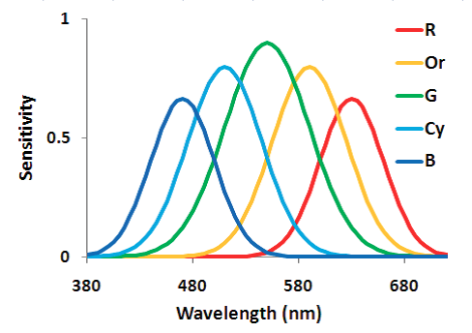
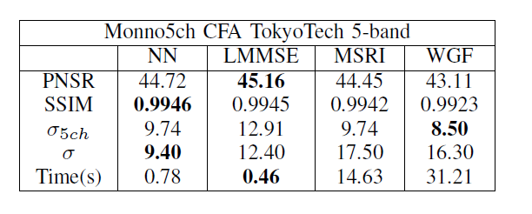
TokyoTech 5-band (Simulation)
NN* LMMSE MSRI
PSNR
MSRI Y. Monno et al. 2014
WGF Y. Monno et al. 2015
*only 6.25% of dataset used for training. 100 neurons. 1.77 hours to train
Notes:
Y. Monno, S. Kikuchi, M. Tanaka, and M. Okutomi, “A practical one-shot multispectral imaging system using a single image sensor,” IEEE Transactions on Image Processing, vol. 24, no. 10, pp. 3048–3059, Oct 2015.
Y. Monno, D. Kiku, S. Kikuchi, M. Tanaka, and M. Okutomi, “Multispectral demosaicking with novel guide image generation and residual interpolation in Image Processing (ICIP), 2014 IEEE International Conference on. IEEE,
2014, pp. 645–649. 224

Slide 18
Training for SFAs

Slide 19
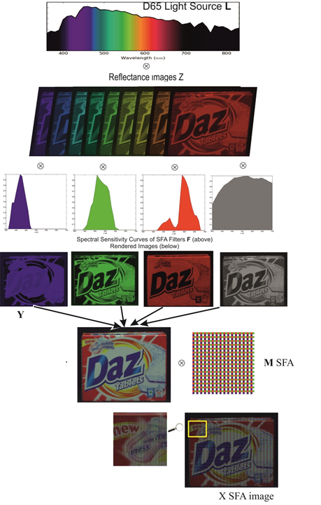
Hyperspectral
Image Formation model

Slide 20
Hyperspectral
Image Formation model
Notes:
Finlayson database

Slide 21
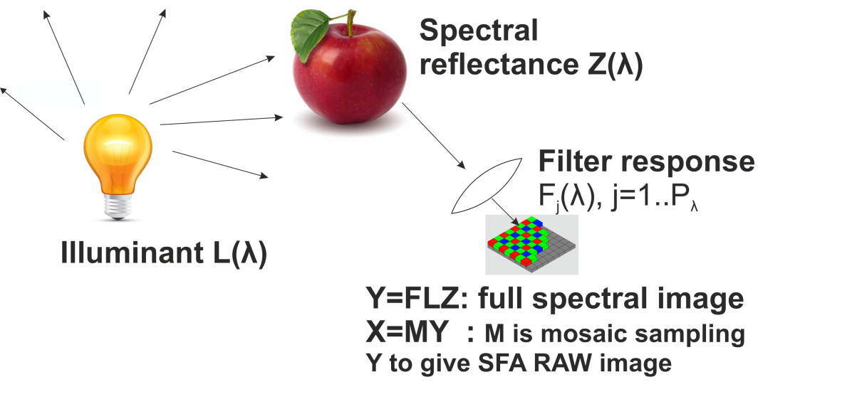
Hyperspectral
Image Formation model

Slide 22
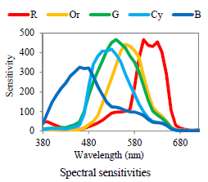
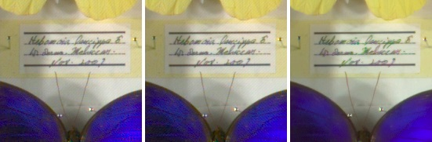
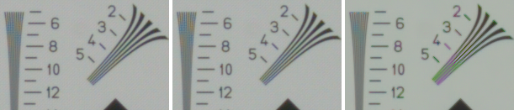
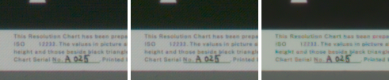
Monno 5ch (RAW Camera)
Neural Network LMMSE WGF
Here we trained on Finlayson database
WGF Y. Monno et al. 2015
Notes:
Thanks to monno and all

Slide 23
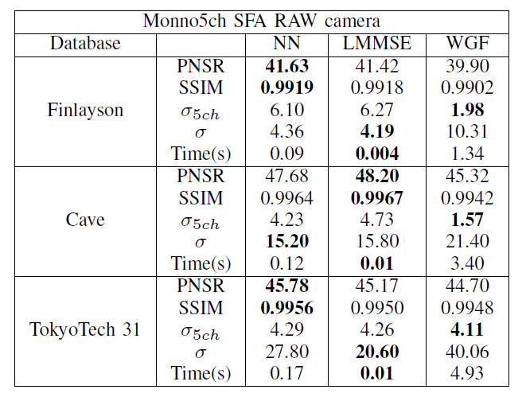
Results (Simulation)
WGF Y. Monno et al. 2015

Slide 24
Conclusion
Proposed a 2 layer feed forward NN comparable to a 15 layer deep learning NN approach for the Kodak database (CFAs)
  Our encoding of the input/output that makes the difference
We test also on a 5 channel SFA proposed by Tokyotech
  Our generic method outperformed the specific algorithms proposed for this SFA
    Better PSNR and lower time
We still have artifacts in flat regions of the image

Slide 25
Thank You

