Slide 1
A sub-Riemannian cortical model with
frequency-phase and its applications
Emre Baspinar
Joint work with
Giovanna Citti
Alessandro Sarti
hart

Slide 2
Outline
Part 0
Part I
Part II-a
Part II-b

Slide 3
Part 0: General information
Part 0
Part I
Part II-a
Part II-b

Slide 4
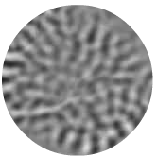
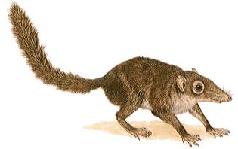
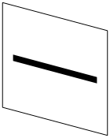
Simple cells
Simple cells are sensitive to:
orientation
frequency
phase…
Notes:
-THANKS TO THE ORIENTATION WE DISTINGUISH

Slide 5
Simple cells
Simple cells are sensitive to:
orientation
frequency
phase…
Notes:
-THANKS TO THE ORIENTATION WE DISTINGUISH

Slide 6
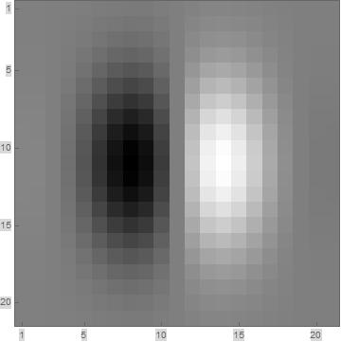
Simple cell receptive profiles: Gabor functions
Experimental receptive profile
Gabor (odd) function
Notes:
-if we restrict ourselves ONLY ORIENTATION SELECTIVE CASE,
-ODD PART OF GABOR MOTHER FCN

Slide 7
Simple cell receptive profiles: Gabor functions
Experimental receptive profile
Gabor (odd) function

Slide 8
Simple cell receptive profiles: Gabor functions
Experimental receptive profile
Gabor (odd) function

Slide 9
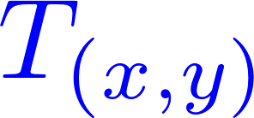
Simple cell receptive profiles: Gabor functions
Experimental receptive profile
Gabor (odd) function

Slide 10
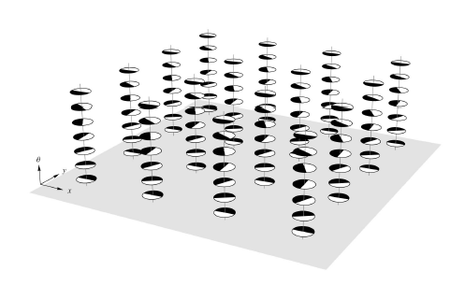
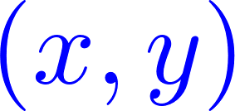
Simple cell receptive profiles: Gabor functions
Experimental receptive profile
Gabor (odd) function
Set of receptive profiles

Slide 11
Cortical models of visual perception
Set of receptive profiles

Slide 12
Cortical models of visual perception
Set of receptive profiles

Slide 13
Simple cell receptive profiles: Gabor functions
One form

Slide 14
Simple cell receptive profiles: Gabor functions
One form

Slide 15
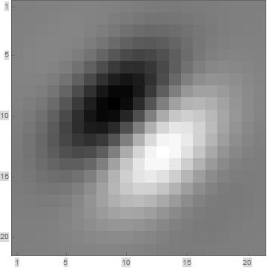
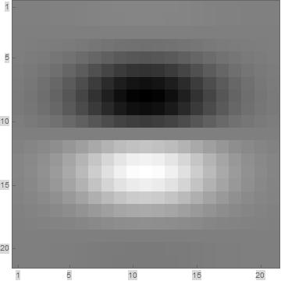
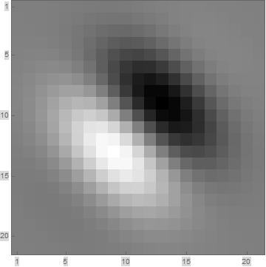
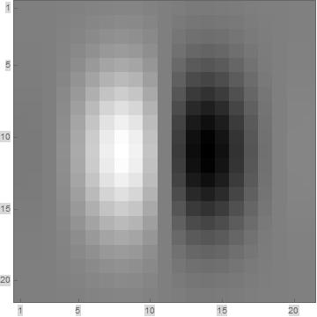
Simple cell receptive profiles: Gabor functions
One form

Slide 16
Simple cell receptive profiles: Gabor functions
One form

Slide 17
Simple cell receptive profiles: Gabor functions
One form

Slide 18
Simple cell receptive profiles: Gabor functions
One form

Slide 19
Simple cell receptive profiles: Gabor functions
One form

Slide 20
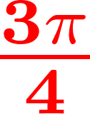
Simple cell receptive profiles: Gabor functions
One form

Slide 21
Simple cell receptive profiles: Gabor functions
One form

Slide 22
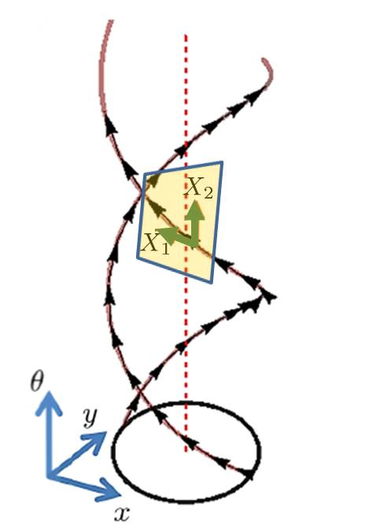
geometry as a cortical model
Horizontal tangent space

Slide 23
geometry as a cortical model
Horizontal tangent space
Sub-Riemannian metric tensor

Slide 24
geometry as a cortical model
Horizontal tangent space
Sub-Riemannian metric tensor
Sub-Riemannian structure

Slide 25
geometry as a cortical model
Horizontal tangent space
Sub-Riemannian metric tensor
Sub-Riemannian structure
Good model of the neural connectivity!

Slide 26
geometry as a cortical model
Horizontal tangent space
Sub-Riemannian metric tensor
Sub-Riemannian structure
Citti-Sarti cortical model
Good model of the neural connectivity!

Slide 27
Part I: A new cortex model
Part 0
Part I
Part II-a
Part II-b

Slide 28
Part I: A new cortex model
Part 0
Part I
Part II-a
Part II-b

Slide 29
Extension to frequency and phase
Notes:
-Following the model of Citti-Sarti, we provide an extension of the model, which is selective to only orientation.
-Now the we extend the model of Citti-Sarti in such a way that we can model not only orientation selectivity but also frequency selectivity of simple cells with their shifted phase behavior.
-Now in addition to the spatial variables x,y, orientation variable \theta, we have the frequency variable \omega and the phase variable \phi. Therefore now we are in a 5-dim space and we will see that it is associtaed to a 5-dim sR-geometry which contains SE(2), the sR-geometry of the Citti-Sarti model at each frequency-phase pair.
-We take the advantage of the versatility of the Gabor functions and introducing the frequency and phase variables in the Gabor functions we find our receptive field model.
-Note that a one form follows directly from the generalized Gabor function.
-This is the main instrument which renders the orientation-frequency selective behavior of simple cells with shifted phases.

Slide 30
Extension to frequency and phase
Notes:
-Following the model of Citti-Sarti, we provide an extension of the model, which is selective to only orientation.
-Now the we extend the model of Citti-Sarti in such a way that we can model not only orientation selectivity but also frequency selectivity of simple cells with their shifted phase behavior.
-Now in addition to the spatial variables x,y, orientation variable \theta, we have the frequency variable \omega and the phase variable \phi. Therefore now we are in a 5-dim space and we will see that it is associtaed to a 5-dim sR-geometry which contains SE(2), the sR-geometry of the Citti-Sarti model at each frequency-phase pair.
-We take the advantage of the versatility of the Gabor functions and introducing the frequency and phase variables in the Gabor functions we find our receptive field model.
-Note that a one form follows directly from the generalized Gabor function.
-This is the main instrument which renders the orientation-frequency selective behavior of simple cells with shifted phases.

Slide 31
Extension to frequency and phase
Notes:
-Following the model of Citti-Sarti, we provide an extension of the model, which is selective to only orientation.
-Now the we extend the model of Citti-Sarti in such a way that we can model not only orientation selectivity but also frequency selectivity of simple cells with their shifted phase behavior.
-Now in addition to the spatial variables x,y, orientation variable \theta, we have the frequency variable \omega and the phase variable \phi. Therefore now we are in a 5-dim space and we will see that it is associtaed to a 5-dim sR-geometry which contains SE(2), the sR-geometry of the Citti-Sarti model at each frequency-phase pair.
-We take the advantage of the versatility of the Gabor functions and introducing the frequency and phase variables in the Gabor functions we find our receptive field model.
-Note that a one form follows directly from the generalized Gabor function.
-This is the main instrument which renders the orientation-frequency selective behavior of simple cells with shifted phases.

Slide 32
Extension to frequency and phase
Notes:
-Following the model of Citti-Sarti, we provide an extension of the model, which is selective to only orientation.
-Now the we extend the model of Citti-Sarti in such a way that we can model not only orientation selectivity but also frequency selectivity of simple cells with their shifted phase behavior.
-Now in addition to the spatial variables x,y, orientation variable \theta, we have the frequency variable \omega and the phase variable \phi. Therefore now we are in a 5-dim space and we will see that it is associtaed to a 5-dim sR-geometry which contains SE(2), the sR-geometry of the Citti-Sarti model at each frequency-phase pair.
-We take the advantage of the versatility of the Gabor functions and introducing the frequency and phase variables in the Gabor functions we find our receptive field model.
-Note that a one form follows directly from the generalized Gabor function.
-This is the main instrument which renders the orientation-frequency selective behavior of simple cells with shifted phases.

Slide 33
Extension to frequency and phase
Notes:
-Following the model of Citti-Sarti, we provide an extension of the model, which is selective to only orientation.
-Now the we extend the model of Citti-Sarti in such a way that we can model not only orientation selectivity but also frequency selectivity of simple cells with their shifted phase behavior.
-Now in addition to the spatial variables x,y, orientation variable \theta, we have the frequency variable \omega and the phase variable \phi. Therefore now we are in a 5-dim space and we will see that it is associtaed to a 5-dim sR-geometry which contains SE(2), the sR-geometry of the Citti-Sarti model at each frequency-phase pair.
-We take the advantage of the versatility of the Gabor functions and introducing the frequency and phase variables in the Gabor functions we find our receptive field model.
-Note that a one form follows directly from the generalized Gabor function.
-This is the main instrument which renders the orientation-frequency selective behavior of simple cells with shifted phases.

Slide 34
Extension to frequency and phase
Notes:
-Following the model of Citti-Sarti, we provide an extension of the model, which is selective to only orientation.
-Now the we extend the model of Citti-Sarti in such a way that we can model not only orientation selectivity but also frequency selectivity of simple cells with their shifted phase behavior.
-Now in addition to the spatial variables x,y, orientation variable \theta, we have the frequency variable \omega and the phase variable \phi. Therefore now we are in a 5-dim space and we will see that it is associtaed to a 5-dim sR-geometry which contains SE(2), the sR-geometry of the Citti-Sarti model at each frequency-phase pair.
-We take the advantage of the versatility of the Gabor functions and introducing the frequency and phase variables in the Gabor functions we find our receptive field model.
-Note that a one form follows directly from the generalized Gabor function.
-This is the main instrument which renders the orientation-frequency selective behavior of simple cells with shifted phases.

Slide 35
Extension to frequency and phase
Simple cell output response
Notes:
-Following the model of Citti-Sarti, we provide an extension of the model, which is selective to only orientation.
-Now the we extend the model of Citti-Sarti in such a way that we can model not only orientation selectivity but also frequency selectivity of simple cells with their shifted phase behavior.
-Now in addition to the spatial variables x,y, orientation variable \theta, we have the frequency variable \omega and the phase variable \phi. Therefore now we are in a 5-dim space and we will see that it is associtaed to a 5-dim sR-geometry which contains SE(2), the sR-geometry of the Citti-Sarti model at each frequency-phase pair.
-We take the advantage of the versatility of the Gabor functions and introducing the frequency and phase variables in the Gabor functions we find our receptive field model.
-Note that a one form follows directly from the generalized Gabor function.
-This is the main instrument which renders the orientation-frequency selective behavior of simple cells with shifted phases.

Slide 36
Extension to frequency and phase
Simple cell output response
Notes:
-Following the model of Citti-Sarti, we provide an extension of the model, which is selective to only orientation.
-Now the we extend the model of Citti-Sarti in such a way that we can model not only orientation selectivity but also frequency selectivity of simple cells with their shifted phase behavior.
-Now in addition to the spatial variables x,y, orientation variable \theta, we have the frequency variable \omega and the phase variable \phi. Therefore now we are in a 5-dim space and we will see that it is associtaed to a 5-dim sR-geometry which contains SE(2), the sR-geometry of the Citti-Sarti model at each frequency-phase pair.
-We take the advantage of the versatility of the Gabor functions and introducing the frequency and phase variables in the Gabor functions we find our receptive field model.
-Note that a one form follows directly from the generalized Gabor function.
-This is the main instrument which renders the orientation-frequency selective behavior of simple cells with shifted phases.

Slide 37
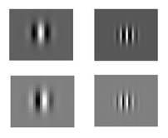
Extension to frequency and phase
One form
Notes:
-Following the model of Citti-Sarti, we provide an extension of the model, which is selective to only orientation.
-Now the we extend the model of Citti-Sarti in such a way that we can model not only orientation selectivity but also frequency selectivity of simple cells with their shifted phase behavior.
-Now in addition to the spatial variables x,y, orientation variable \theta, we have the frequency variable \omega and the phase variable \phi. Therefore now we are in a 5-dim space and we will see that it is associtaed to a 5-dim sR-geometry which contains SE(2), the sR-geometry of the Citti-Sarti model at each frequency-phase pair.
-We take the advantage of the versatility of the Gabor functions and introducing the frequency and phase variables in the Gabor functions we find our receptive field model.
-Note that a one form follows directly from the generalized Gabor function.
-This is the main instrument which renders the orientation-frequency selective behavior of simple cells with shifted phases.

Slide 38
Extension to frequency and phase
Horizontal tangent space
Notes:
-One-form induces the horizontal distribution/generators of the model geometry since the horizontal distribution is defined as the kernel of the one-form.
-

Slide 39
Extension to frequency and phase
Horizontal tangent space
Non-commutive Lie algebra
Notes:
-Note that the generators are non-commutative.

Slide 40
Extension to frequency and phase
Horizontal tangent space
Non-commutive Lie algebra
Satisfies the Hörmander condition!
Notes:
-Thanks to non-commutativity Hormander condition is satisfied and the connectivity in the whole space is guaranteed.

Slide 41
The model as a sub-Riemannian structure
Sub-Riemannian manifold
Notes:
-Now we have the manifold M
-The horizontal distribution, the kernel of the one form \lambda
-The horizontal distribution induces the corresponding metric tensor g, where \chi represents the co-vectors of the horizontal vector fields.
-Finally we can recognize our model as the sub-Riemannia structure, given as the following triple here.
-Note that by exploiting the geometry arising from this model we can perform different image processing applications, which employ for example mean curvature flow, or Laplace-Beltrami flow.
-Those two flows are associated to each other.
-At this point I would like to mention about the uniqueness issue of sub-Riemannian mean curvature flow solution.

Slide 42
The model as a sub-Riemannian structure
Sub-Riemannian manifold
Horizontal tangent space
Notes:
-Now we have the manifold M
-The horizontal distribution, the kernel of the one form \lambda
-The horizontal distribution induces the corresponding metric tensor g, where \chi represents the co-vectors of the horizontal vector fields.
-Finally we can recognize our model as the sub-Riemannia structure, given as the following triple here.
-Note that by exploiting the geometry arising from this model we can perform different image processing applications, which employ for example mean curvature flow, or Laplace-Beltrami flow.
-Those two flows are associated to each other.
-At this point I would like to mention about the uniqueness issue of sub-Riemannian mean curvature flow solution.

Slide 43
The model as a sub-Riemannian structure
Sub-Riemannian manifold
Horizontal tangent space
Sub-Riemannian metric tensor
Notes:
-Now we have the manifold M
-The horizontal distribution, the kernel of the one form \lambda
-The horizontal distribution induces the corresponding metric tensor g, where \chi represents the co-vectors of the horizontal vector fields.
-Finally we can recognize our model as the sub-Riemannia structure, given as the following triple here.
-Note that by exploiting the geometry arising from this model we can perform different image processing applications, which employ for example mean curvature flow, or Laplace-Beltrami flow.
-Those two flows are associated to each other.
-At this point I would like to mention about the uniqueness issue of sub-Riemannian mean curvature flow solution.

Slide 44
The model as a sub-Riemannian structure
Sub-Riemannian manifold
Horizontal tangent space
Sub-Riemannian metric tensor
Sub-Riemannian structure
Notes:
-Now we have the manifold M
-The horizontal distribution, the kernel of the one form \lambda
-The horizontal distribution induces the corresponding metric tensor g, where \chi represents the co-vectors of the horizontal vector fields.
-Finally we can recognize our model as the sub-Riemannia structure, given as the following triple here.
-Note that by exploiting the geometry arising from this model we can perform different image processing applications, which employ for example mean curvature flow, or Laplace-Beltrami flow.
-Those two flows are associated to each other.
-At this point I would like to mention about the uniqueness issue of sub-Riemannian mean curvature flow solution.

Slide 45
Part II-a: Image enhancement
Part 0
Part I
Part II-a
Part II-b

Slide 46
Part II-a: Image enhancement
Part 0
Part I
Part II-a
Part II-b

Slide 47
Image enhancement
Noisy image
Original image

Slide 48
Simple cell outputs
Simple cell output

Slide 49
Simple cell outputs
Simple cell output
Notes:
-The algorithm starts with finding the simple cell output responses for the whole stimulus on the retinal plane.
-It is found via the classical method of filtering the stimulus with rotated Gabor filter banks of each ferquency-phase pair.
-Note that this transform induces the 5-dimensional sub-Riemannian space \mathcal{M}, that is output is defined on the 5-dim space.
-Enhancement is achieved thanks to a Laplace-Beltrami evolution.
-Finally, since we use all frequency components of the Gabor filtering, it is possible to apply inverse Gabor transfrom and the inverse transform projects the enchanced functions defined in the 5-dim
Space to the image functions defined on the 2-dim retinal plane.

Slide 50
Simple cell outputs
Simple cell output

Slide 51
Laplace-Beltrami evolution
Notes:
-But differently from Kimmel we use MULTI-FREQ. not MULTI-SCALE EVOLUTIONS
-differently from Remco: not Heisenberg-Weyl setting but our MODEL FRAMEWORK

Slide 52
Laplace-Beltrami evolution
Horizontal tangent space

Slide 53
Laplace-Beltrami evolution
Horizontal tangent space
Laplace-Beltrami operator

Slide 54
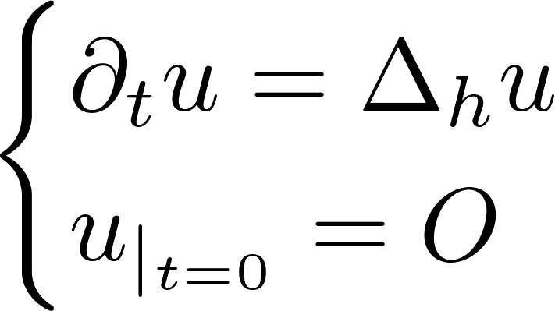
Laplace-Beltrami evolution
Horizontal tangent space
Laplace-Beltrami operator
Evolution equation

Slide 55
Laplace-Beltrami evolution
Horizontal tangent space
Laplace-Beltrami operator
Evolution equation

Slide 56
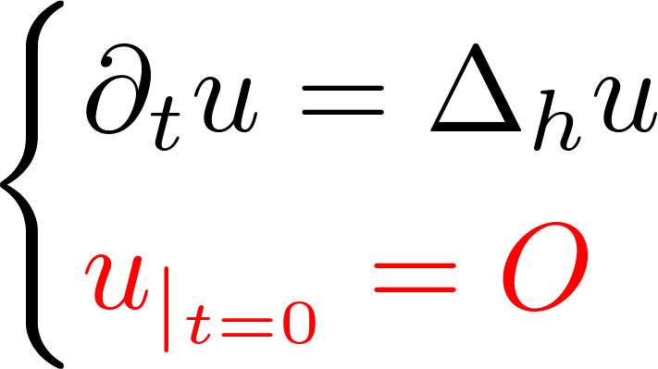
Laplace-Beltrami evolution
Horizontal tangent space
Laplace-Beltrami operator
Evolution equation
Notes:
-we don’t want EXCESSIVE BLURRING-NO DIFFUSION IN IMAGE GRADIENT DIRECTION
-APPROXIMATE THE GEOMETRY AND APPLY THE LAPLACE BELTRAMI IN EACH FREQUENCY CHANNEL!
-PHASE NOT IN THE ENHANCEMENT BUT IN COMPLETION HAS ITS ROLE!

Slide 57
Returning back to the image plane
Inverse Gabor transform

Slide 58
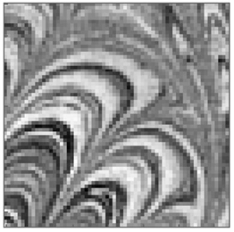
Image enhancement results
Initial image
Multi-freq. Laplace-Beltrami
Multi-scale Laplace-Beltrami
Kimmel et. al., 2000
Notes:
Some example results can be sen here.

Slide 59
Part II-b: Multi-feature orientation map generation
Part 0
Part I
Part II-a
Part II-b

Slide 60
Part II-b: Multi-feature orientation map generation
Part 0
Part I
Part II-a
Part II-b

Slide 61
Orientation map and pinwheels
Orientation preference map
[Bosking et. al., 1997]

Slide 62
Orientation map and pinwheels
Orientation preference map
[Bosking et. al., 1997]
Pinwheels
[Petitot, Neurogéométrie de la vision, 2008]

Slide 63
Multi-feature orientation map construction
Simple cell output
Notes:
-The algorithm starts with finding the simple cell output responses for the whole stimulus on the retinal plane.
-It is found via the classical method of filtering the stimulus with rotated Gabor filter banks of each ferquency-phase pair.
-Note that this transform induces the 5-dimensional sub-Riemannian space \mathcal{M}, that is output is defined on the 5-dim space.
-Enhancement is achieved thanks to a Laplace-Beltrami evolution.
-Finally, since we use all frequency components of the Gabor filtering, it is possible to apply inverse Gabor transfrom and the inverse transform projects the enchanced functions defined in the 5-dim
Space to the image functions defined on the 2-dim retinal plane.

Slide 64
Multi-feature orientation map construction
Simple cell output
Noise image?
Notes:
-The algorithm starts with finding the simple cell output responses for the whole stimulus on the retinal plane.
-It is found via the classical method of filtering the stimulus with rotated Gabor filter banks of each ferquency-phase pair.
-Note that this transform induces the 5-dimensional sub-Riemannian space \mathcal{M}, that is output is defined on the 5-dim space.
-Enhancement is achieved thanks to a Laplace-Beltrami evolution.
-Finally, since we use all frequency components of the Gabor filtering, it is possible to apply inverse Gabor transfrom and the inverse transform projects the enchanced functions defined in the 5-dim
Space to the image functions defined on the 2-dim retinal plane.

Slide 65
Multi-feature orientation map construction
Simple cell output

Slide 66
Multi-feature orientation map construction
Simple cell output
Integration over fibers

Slide 67
Multi-feature orientation map construction
Simple cell output
Integration over fibers
Set of receptive profiles
Notes:
-Here mentione how in real experiments people obtain the orientation preference maps-The integration over fibers is motivated by that technique.

Slide 68
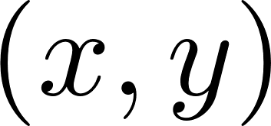
Multi-feature orientation map construction
Simple cell output
Integration over fibers

Slide 69
Multi-feature orientation map construction
Simple cell output
Integration over fibers

Slide 70
Multi-feature orientation map construction
Simple cell output
Integration over fibers

Slide 71
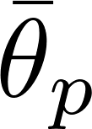
Multi-feature orientation map construction
Simple cell output
Integration over fibers

Slide 72
Multi-feature orientation map construction
Simple cell output
Integration over fibers
Preferred feature values

Slide 73
Multi-feature orientation map construction
Simple cell output
Integration over fibers
Preferred feature values
Example case

Slide 74
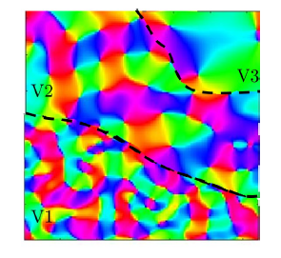
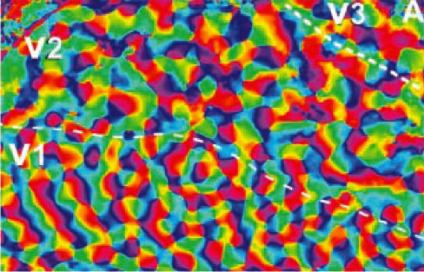
Multi-scale orientation map construction
Real orientation map
[Petitot, Neurogéométrie de la vision, 2008]
Model multi-scale orientation map
E. B., G. Citti & A. Sarti, J Math Imaging Vis (2018)

Slide 75
Conclusion
Part 0
Part I
Part II-a
Part II-b

Slide 76
Conclusion
Part 0
Part I
Part II-a
Part II-b

Slide 77
Conclusion
Part 0
Part I
Part II-a
Part II-b

Slide 78
Thank you!
78

Slide 80
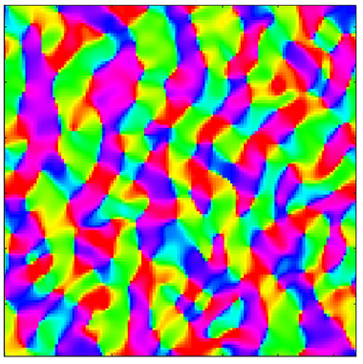
Multi-frequency orientation map construction
Experimental orientation map
[Petitot, Neurogéométrie de la vision, 2008]
Model multi-freq. orientation map
In collaboration with Jonathan Touboul & JérÔme Ribot

Slide 81
Multi-feature orientation map construction
Simple cell output
Integration over fibers

Slide 82
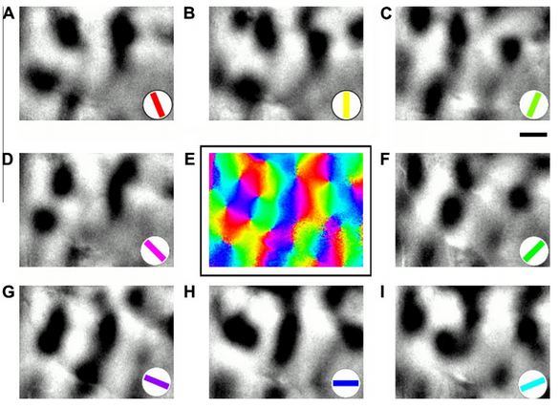
Multi-feature orientation map construction
Simple cell output
Integration over fibers
Real orientation map construction
[Crair et. al., 2010]
Notes:
-For each orientation angle, the high responsive part shows the region of the cortex where we find the cells SENSITIVE TO THAT ORIENTATIN ANGLE.
-In order to VECTORIZE, they multiply the output response value with the VECTOR/EXPONENTIAL in the same direction as the orientatino angle.
-Then VECTOR SUM.
-IN ORDER TO VECTORIZE THE RESPONSE MEASUREMENTS THEY MULTIPLY THE MEASURED RESPONSE VALUES WITH THE EXPONENTIAL WITH THE ORIENTATION ANGLE CORRESPONDING TO THE ONE OF THE HIGH RESPONSIVE PART OF THE VISUAL CORTEX.

Slide 83
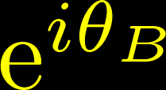
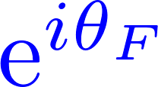
Multi-feature orientation map construction
Simple cell output
Integration over fibers
Real orientation map construction
[Crair et. al., 2010]
Notes:
-So we do not only obtain the orientaiton preference maps, but also able to obtain them in the same way as in the real neurphysiological way. It means that our stimulus choice-noise image-and our receptive profile choice based on Gabor functions, can produce a close model of simpe cell output responses.

Slide 84
Multi-feature orientation map construction
Simple cell output
Integration over fibers
Real orientation map construction
[Crair et. al., 2010]
Notes:
-So we do not only obtain the orientaiton preference maps, but also able to obtain them in the same way as in the real neurphysiological way. It means that our stimulus choice-noise image-and our receptive profile choice based on Gabor functions, can produce a close model of simpe cell output responses.

Slide 85
Multi-feature orientation map construction
Simple cell output
Integration over fibers
Real orientation map construction
[Crair et. al., 2010]
Notes:
-So we do not only obtain the orientaiton preference maps, but also able to obtain them in the same way as in the real neurphysiological way. It means that our stimulus choice-noise image-and our receptive profile choice based on Gabor functions, can produce a close model of simpe cell output responses.

Slide 86
Multi-feature orientation map construction
Simple cell output
Notes:
-The algorithm starts with finding the simple cell output responses for the whole stimulus on the retinal plane.
-It is found via the classical method of filtering the stimulus with rotated Gabor filter banks of each ferquency-phase pair.
-Note that this transform induces the 5-dimensional sub-Riemannian space \mathcal{M}, that is output is defined on the 5-dim space.
-Enhancement is achieved thanks to a Laplace-Beltrami evolution.
-Finally, since we use all frequency components of the Gabor filtering, it is possible to apply inverse Gabor transfrom and the inverse transform projects the enchanced functions defined in the 5-dim
Space to the image functions defined on the 2-dim retinal plane.

Slide 87
Multi-feature orientation map construction
Simple cell output
Noise image?
Notes:
-The algorithm starts with finding the simple cell output responses for the whole stimulus on the retinal plane.
-It is found via the classical method of filtering the stimulus with rotated Gabor filter banks of each ferquency-phase pair.
-Note that this transform induces the 5-dimensional sub-Riemannian space \mathcal{M}, that is output is defined on the 5-dim space.
-Enhancement is achieved thanks to a Laplace-Beltrami evolution.
-Finally, since we use all frequency components of the Gabor filtering, it is possible to apply inverse Gabor transfrom and the inverse transform projects the enchanced functions defined in the 5-dim
Space to the image functions defined on the 2-dim retinal plane.

Slide 88
List of publications and manuscripts
Notes:
-The algorithm starts with finding the simple cell output responses for the whole stimulus on the retinal plane.
-It is found via the classical method of filtering the stimulus with rotated Gabor filter banks of each ferquency-phase pair.
-Note that this transform induces the 5-dimensional sub-Riemannian space \mathcal{M}, that is output is defined on the 5-dim space.
-Enhancement is achieved thanks to a Laplace-Beltrami evolution.
-Finally, since we use all frequency components of the Gabor filtering, it is possible to apply inverse Gabor transfrom and the inverse transform projects the enchanced functions defined in the 5-dim
Space to the image functions defined on the 2-dim retinal plane.

Slide 89
Conclusion and new prospects

Slide 90
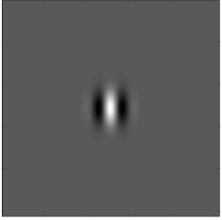
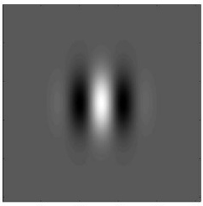
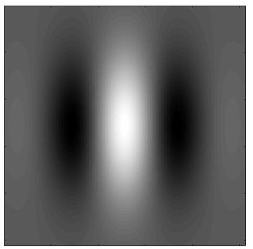
Orientation preference map construction

